Slide 1
Machine Learning-Based Patient Risk Identification for Mental Health and Suicide Prevention
Author: Idani Singo
Mentor: Blessing Olorunfemi

Slide 2
Problem Statement
Despite the rising prevalence of mental health disorder—particularly depression and suicide—traditional approaches to risk assessment remain largely subjective, reactive, and reliant on self-reported symptoms or clinical judgment.
These methods may fail to identify individuals at high risk in time.
This project proposes a data-driven, machine learning-based tool to proactively identify individuals at risk of mental health deterioration or suicide, providing early intervention support to medical professionals.

Slide 3
Introduction
This report summarizes the progress of the Machine Learning (ML)-based patient risk identification project for mental health and suicide prevention.
It outlines the project's objectives, the iterative process of dataset identification and preparation, the development of the ML model, and the challenges encountered during deployment, along with the successful implementation of a Minimum Viable Product (MVP).

Slide 4
Project Context and Objectives
The project aims to develop a data-driven, machine learning-based tool to proactively identify individuals at risk of mental health deterioration or suicide, providing early intervention support to medical professionals. This initiative is driven by both academic interest and personal experience with mental health challenges, aiming to enhance diagnostic accuracy, inform clinical decision-making, and support early interventions.
Target Audience: The primary target audience for this tool is medical professionals (psychologists, psychiatrists, general practitioners). Secondary audiences include researchers, policymakers, institutions, government departments, and organizations interested in mental health advocacy.
Geographic Focus: The project specifically focuses on a South African context.
Approach: The approach involves using machine learning algorithms for classification or predictive modelling. Due to time constraints, the project was agreed to utilize secondary data sources. The tool is designed as a diagnostic support tool for medical professionals, explicitly avoiding direct-to-patient implementation to mitigate risks of misuse or misinterpretation.

Slide 5
Dataset Search and Exploration
The initial phase involved an extensive search for a suitable dataset, primarily focused on South African mental health data, to train and test the ML model.
Initial Search Strategy: The search began using Google Dataset Search with terms like “South Africa mental health dataset,” “Depression anxiety dataset South Africa,” and “National Income Dynamics Study (NIDS)”. DataFirst, a local South African repository, was also explored.
Challenges in Dataset Identification: It was challenging to find datasets with rich mental health-related features, particularly in the South African context, where data is often scarce, fragmented, or not labelled usefully for machine learning. Health-related datasets often do not use "mental health" as a direct searchable label.
Refined Search Strategy: The strategy evolved to include searching for variables like “depression,” “psychological distress,” “emotional well-being,” and “self-reported health” in larger national datasets such as NIDS, GHS, SANHANES, and surveys archived by SAMRC.

Slide 6
Discovery of Qualitative Dataset:
A significant discovery was a qualitative dataset titled "Female undergraduate students’ individual experiences of mental illness stigma" from the University of Pretoria Research Data Repository, authored by Maluleke, Mallory (Mahlori Faith Maluleke). This dataset resonated personally with the researcher due to its focus on mental health stigma, cultural influences, religion, and coping mechanisms among female undergraduate students in South Africa.
Insights from Maluleke's Dissertation: The dataset originates from a mini-dissertation (July 2023) using a descriptive phenomenological approach with semi-structured interviews of nine Black African female undergraduate students. Key themes included mental illness being perceived as "craziness and stupidity," the "pressure to feel strong," the idea that "others have it worse," and the prioritization of "academics first, mental health second." The role of culture in forbidding help-seeking was a consistent theme.
Utility of Qualitative Data: While this qualitative dataset may not directly support predictive modelling, it holds significant contextual value for informing feature selection. However, the raw data (interview transcripts) is not publicly accessible, necessitating outreach to the author for access or discussion.

Slide 7
Selected Dataset
A publicly available "Student Mental Health Dataset" from Kaggle was identified and selected for the project's core ML model development.
This dataset contains responses from university students, collected through a survey aimed at understanding student mental health.
The data includes demographic information such as gender, age, marital status, course of study, year of study, and CGPA.
It also captures the mental health status of each respondent, including whether they experience depression, anxiety, panic attacks, and whether they have sought professional treatment.
The refined project scope targeted depression and anxiety prediction among students, ideally with South African-aligned data, but open to broader student samples.

Slide 8
Input features and target variables
input features: Age Gender Course of Study CGPA Marital Status
Target Variables: Whether a student has depression (Yes/No) Whether they experience anxiety, Whether they have panic attacks

Slide 9
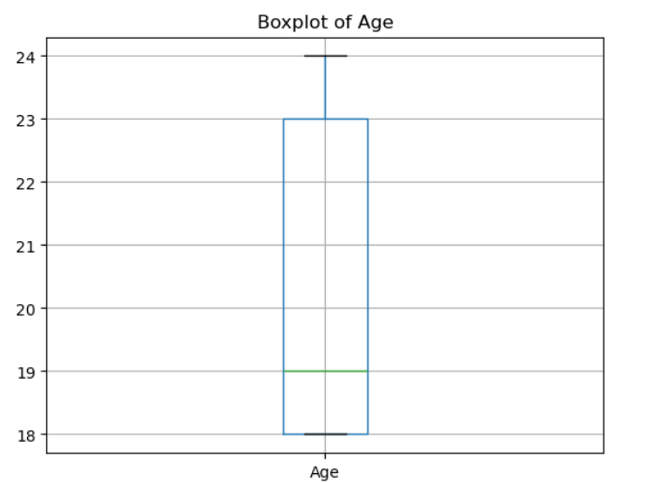
Data Preparation
The dataset was composed of 101 rows and 11 column.
students at university are mostly the same age. we had a null for Age. Did a box and whisker diagram to check the distribution.
Data was skewed to the right for age, so we impute the null value with the median.
Data contained no duplicates.

Slide 10
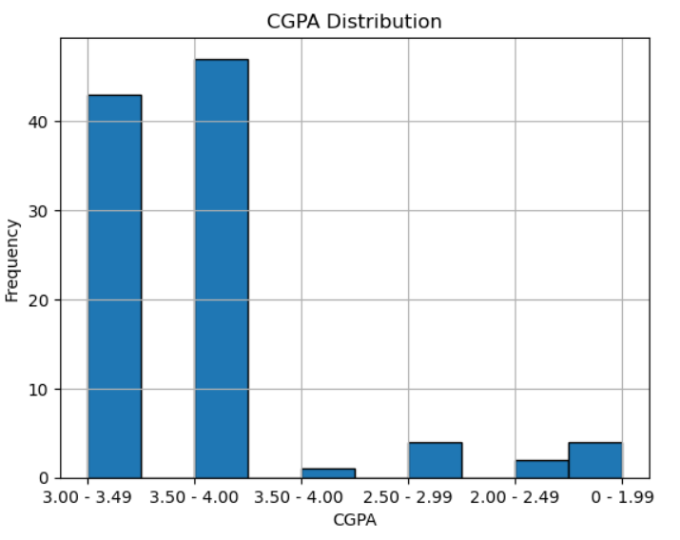
EDA
We had two numeric columns in our dataset: Age and CGPA.
Age had no outliers as we can see previously.
CGPA was in ranges, so we used a histogram as seen from the right.
No outliers, however, the data is skewed to the left. A CGPA of above 3 is however very good.
Most of these students are performing well

Slide 11
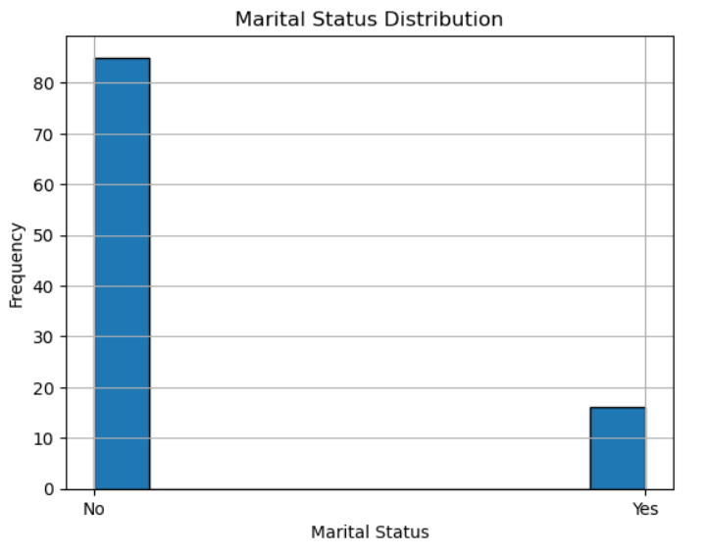
Further data Exploration done
over 80% of these students are not married.

Slide 12
Further data exploration done
Other columns we had were:
Do you have Depression?
Do you have Anxiety?
Do you have Panic attack?
Did you seek any specialist for a treatment?
depression Count: 35
Anxiety Count: 34
Panic attack Count: 33
sought treatment Count: 6

Slide 13

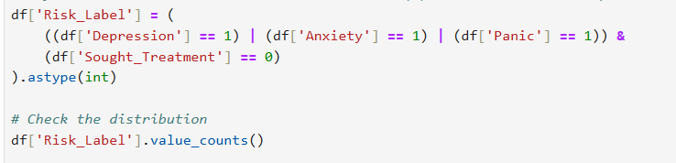
Model development
Define risk label: has mental health condition(s) but did not seek help
Output:

Slide 14
Model development
Feature Selection and Risk Labelling: Key mental health features selected included: "Do you have Depression?", "Do you have Anxiety?", "Do you have Panic attack?", and "Did you seek any specialist for a treatment?" These were mapped from categorical Yes/No to binary 1/0 variables. A composite Risk_Label was created to identify students likely at risk, defined as having any of depression, anxiety, or panic attack AND not having sought treatment. The distribution showed 58 students at risk and 42 not at risk.
Model Training and Evaluation:
A Random Forest classifier was initially trained, achieving 100% accuracy, which was likely due to overfitting the small dataset.
Subsequently, a Logistic Regression model was trained, yielding an 85% accuracy with good recall (catching all at-risk students), deemed more realistic and trustworthy. This model serves as a reliable baseline for risk prediction.

Slide 15
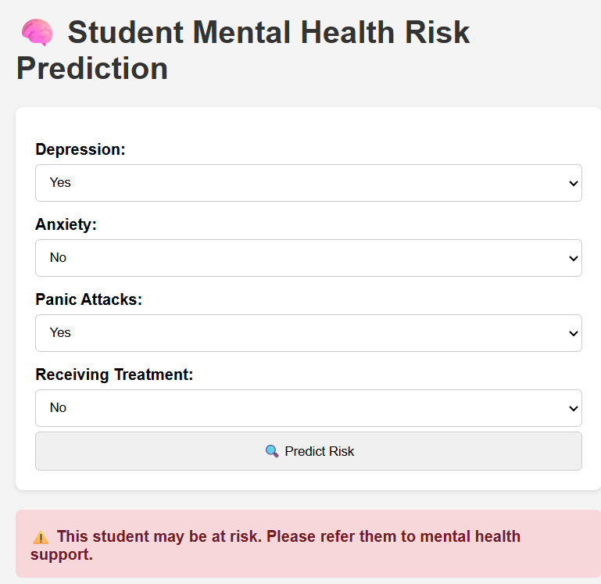
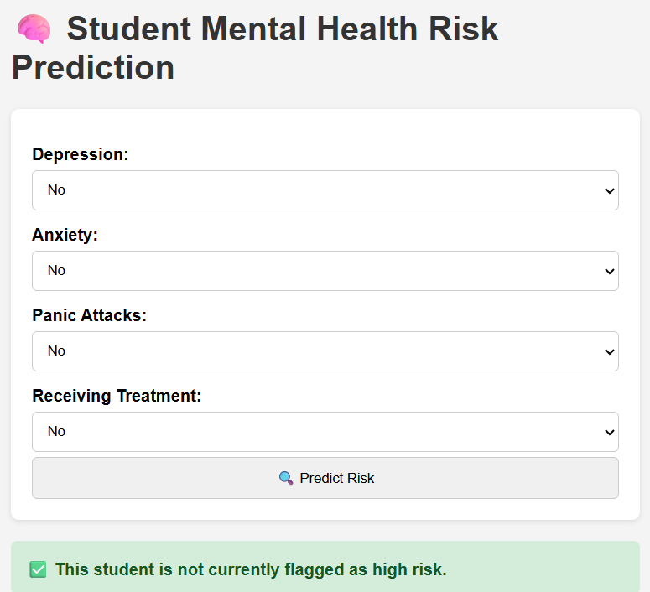
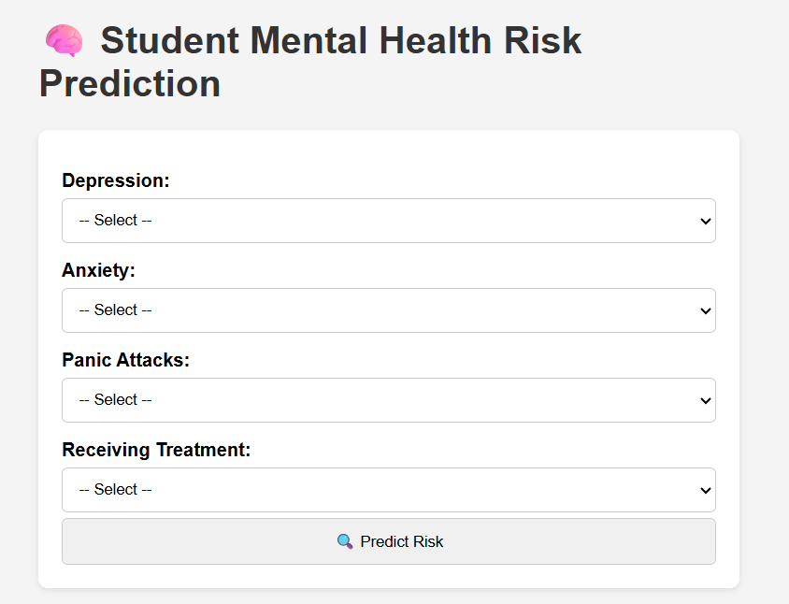
UI Snippets

